Slide 1
CCD Camera Design for Biometric Imaging
Presented By: S.E Nickols, CTO , DMR LLC

Slide 2
Nick’s Background.
Experience: Over 20 years of electro-optical system design, design analysis, design verification experience, and product certification. Have recent experience with medical device development and involvement with design control/regulatory issues (class II and III).
Industries: Scientific, Semiconductor, and Medical.
Interests: Projects requiring a multidisciplinary approach to solve a customer’s problem.
Approach: Team player. Quality Oriented. Process oriented. Customer oriented.
What I Bring to table: Aside from technical skill and experience, “hindsight”, a can-do attitude, flexible, strong adaptation skills, open minded, here to make you money.

Slide 3
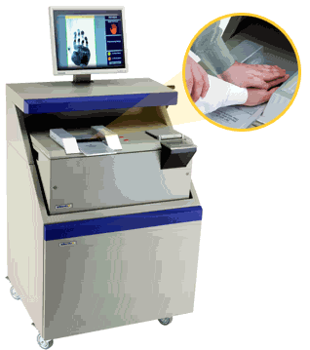
CCD Camera Design for Biometric Imaging
CCD (finger roll) Camera
Formally employed with Identix Inc. as the Director of Engineering.
Designed the CCD camera electronics for the TP3800 Imaging system.
Characterized camera and Optics for FBI appendix F certification.

Slide 4
Project Issues (Big Picture View).
TP2000 product release was behind schedule.
Several components, including the CCD, were at end of life.
Optical Scanner partner located in Russia.
A new finger role camera needed to be designed.
Camera had to be compatible with current Optics design.
Camera had to be firmware compatible with current video processing engine.
It was vital that the camera meet certification requirements and be integrated in to the TP2000 by 11/2001.

Slide 5
Design Process
Come up to speed with Identix technology.
Benchmark Old CCD camera design.
“Reverse engineer” Optics and mechanical assemblies.
Come up to speed with Identix certification requirements.
Develop a design specification.
Resolve design requirements with component availability.
Work out CCD delivery issues with Sony. ( ICX285 was a new part).
Implement design.

Slide 6
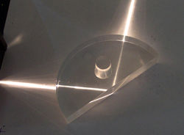
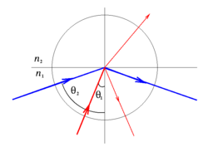
Identix Imaging Technology.
Biometric imaging exploits the principle of “Frustrated Total Internal Reflection”.
Index difference looks like a high impedance to the light.
Total Internal Reflection
Frustrated Total Internal Reflection

Slide 7
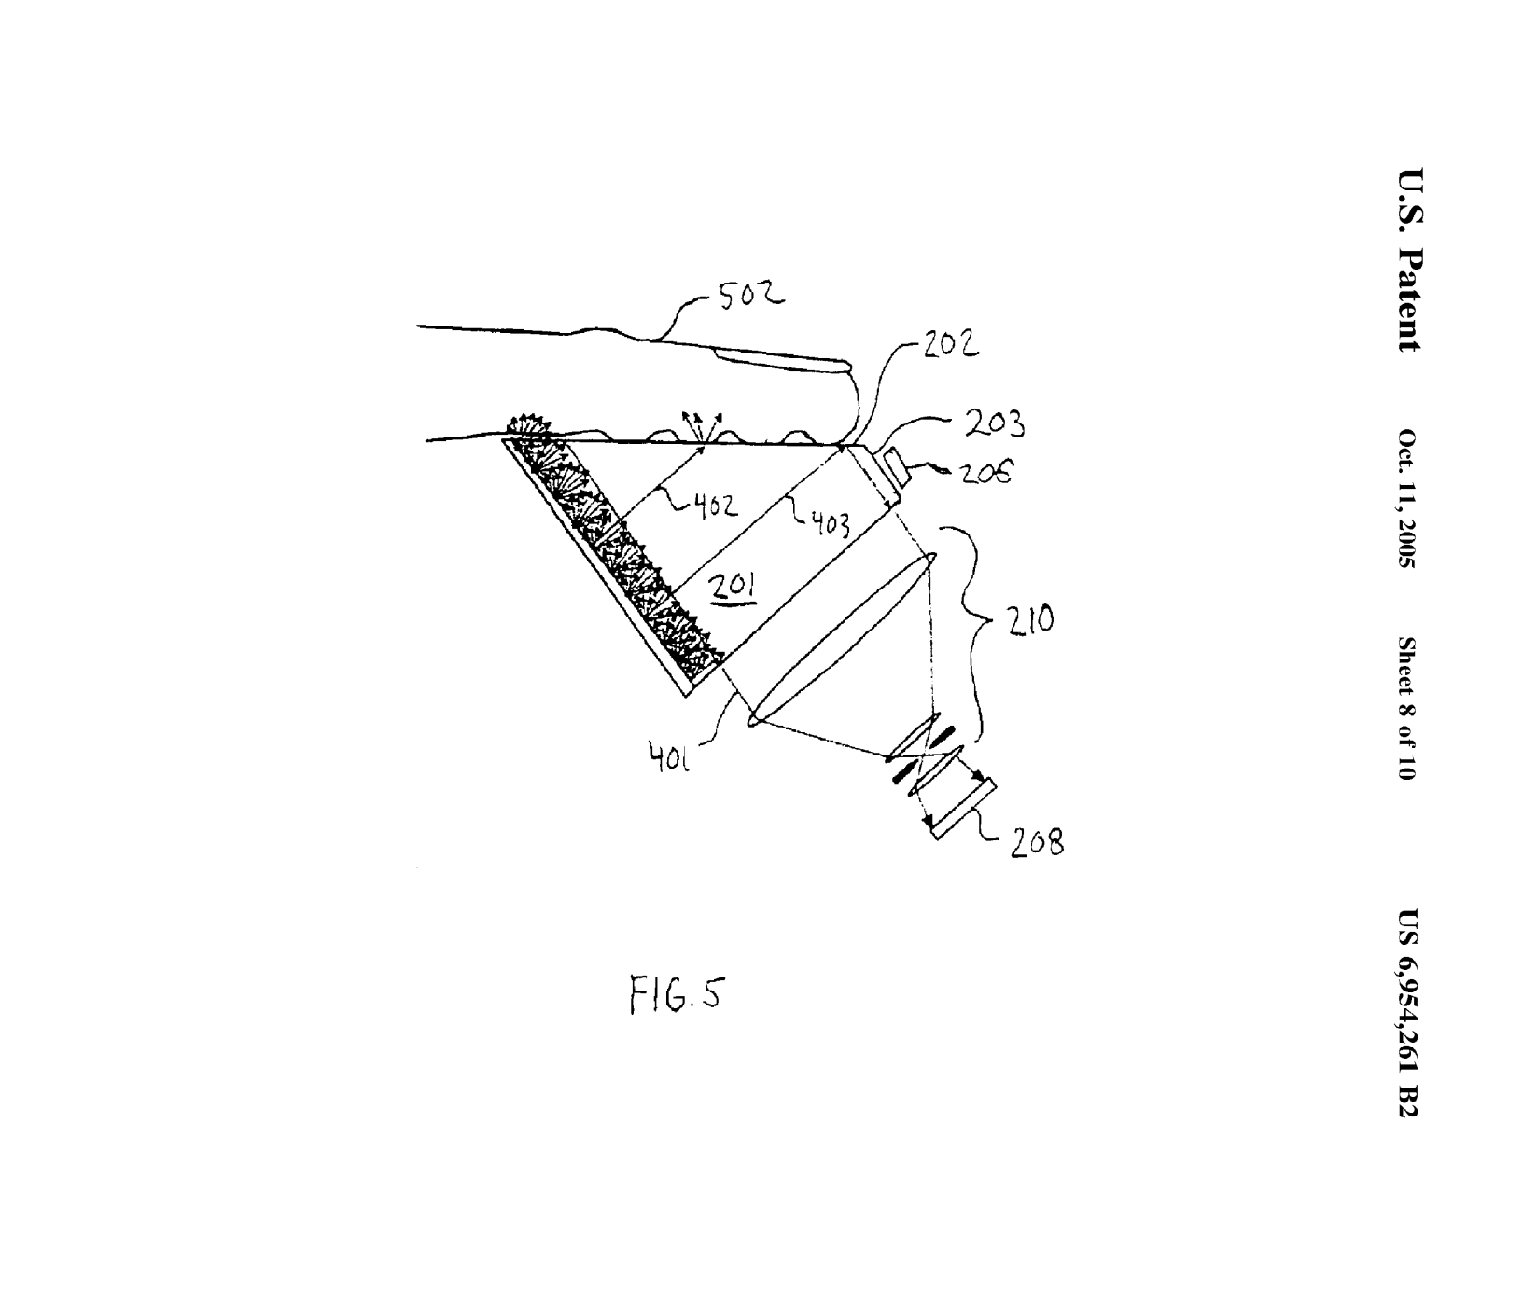
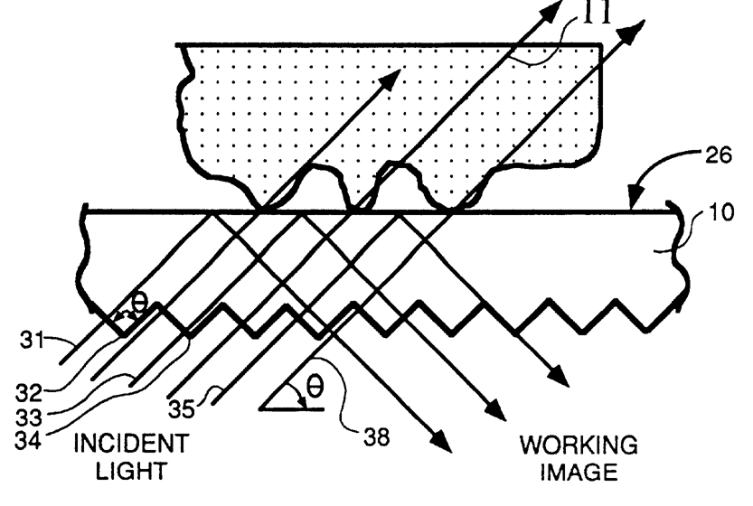
Finger Print Imaging
Light wavelength is important (780nm).

Slide 8
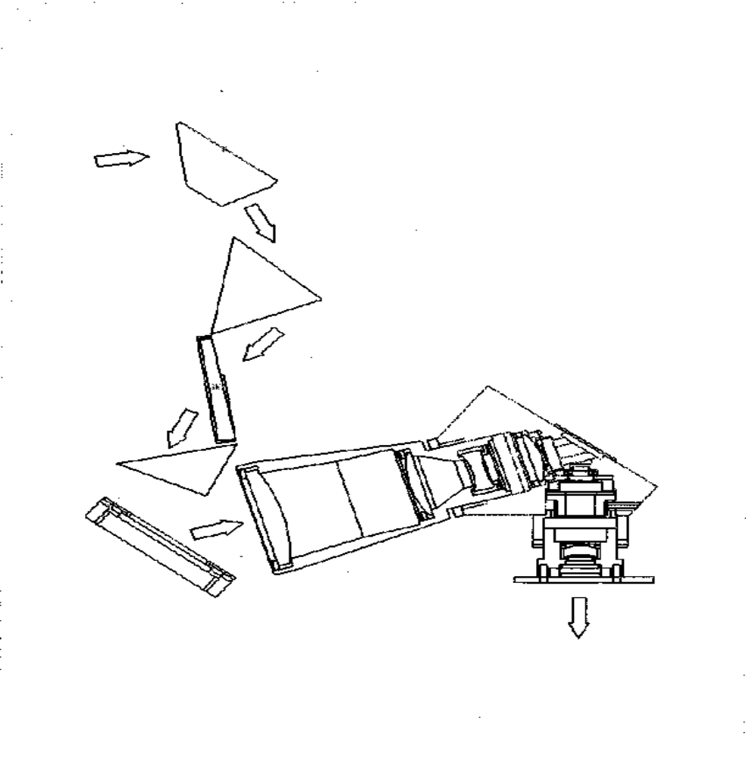
Finger Roll Optics

Slide 9
Interline CCD Technology Simplified
Vertical Charge transfer Gate
Vertical CCD Shift Register
Photo Diodes (Pixels)
Vertical Column Registers Shift in Parallel
Horizontal Charge transfer Gate
Horizontal CCD Shift Register
Pixel Buffer
Horizontal Pixels Shift Horizontally.

Slide 10
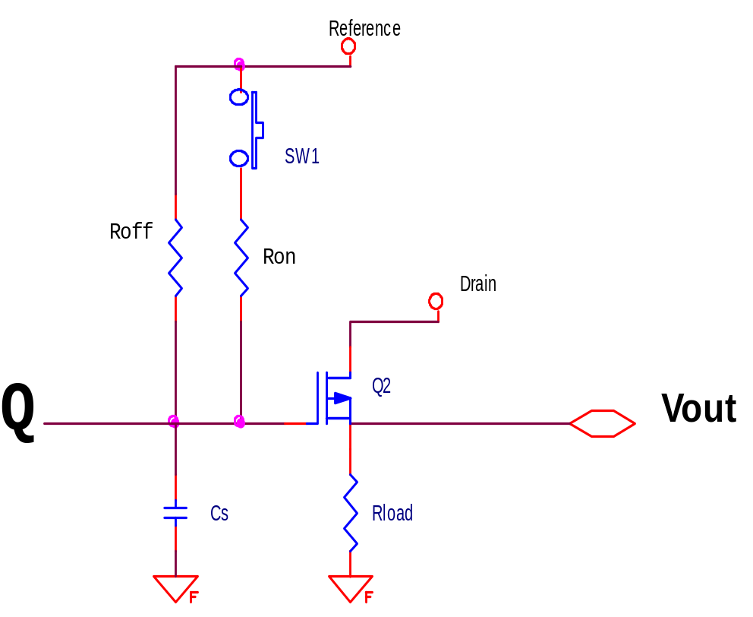
On chip output stage.
1/f noise
Reset Noise
Reset noise + White noise
Ron
Roff
White noise

Slide 11
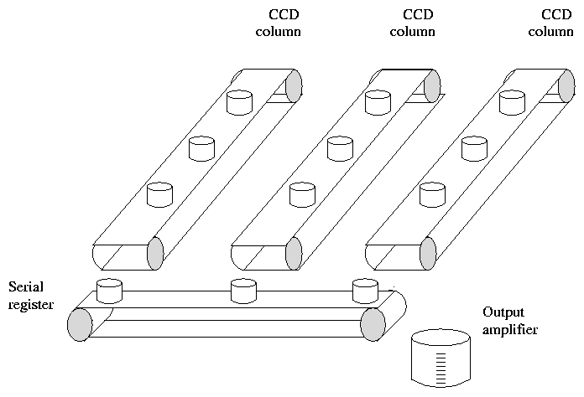
Charge Integration Analogy

Slide 12
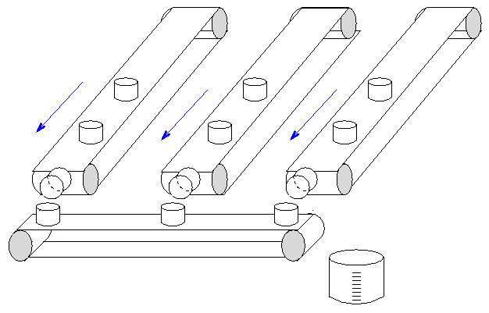
Charge Transfer Analogy

Slide 13
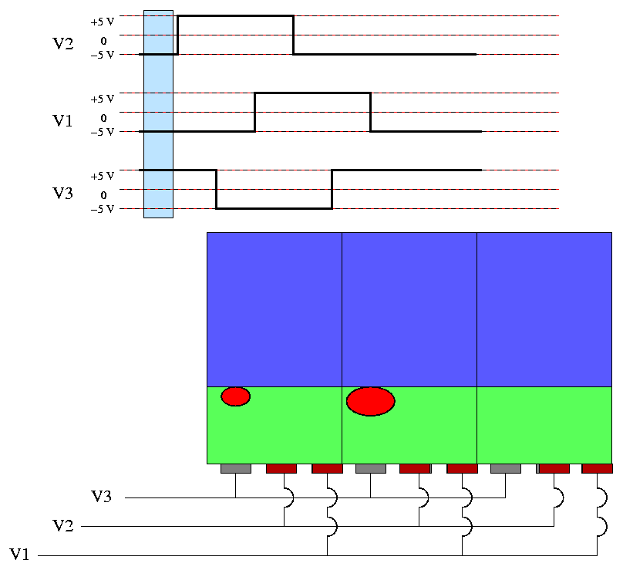
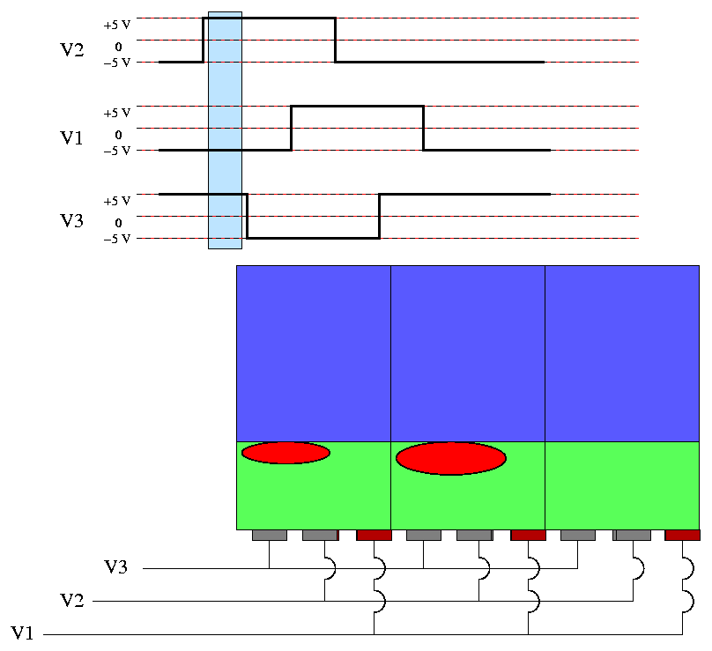
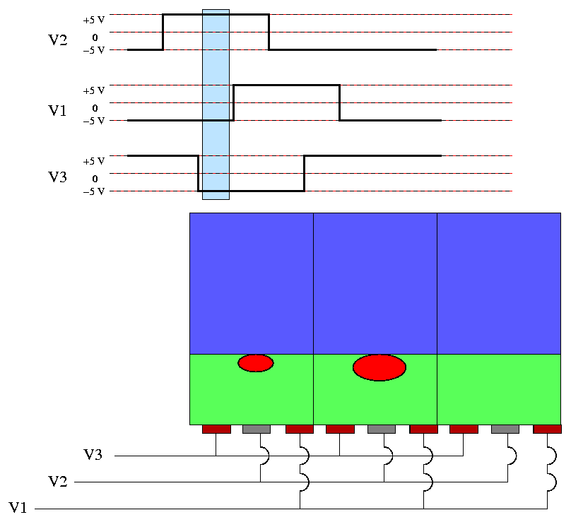
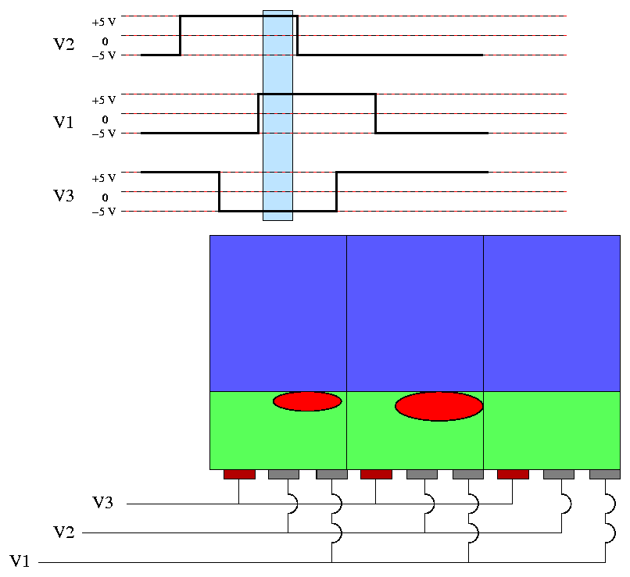
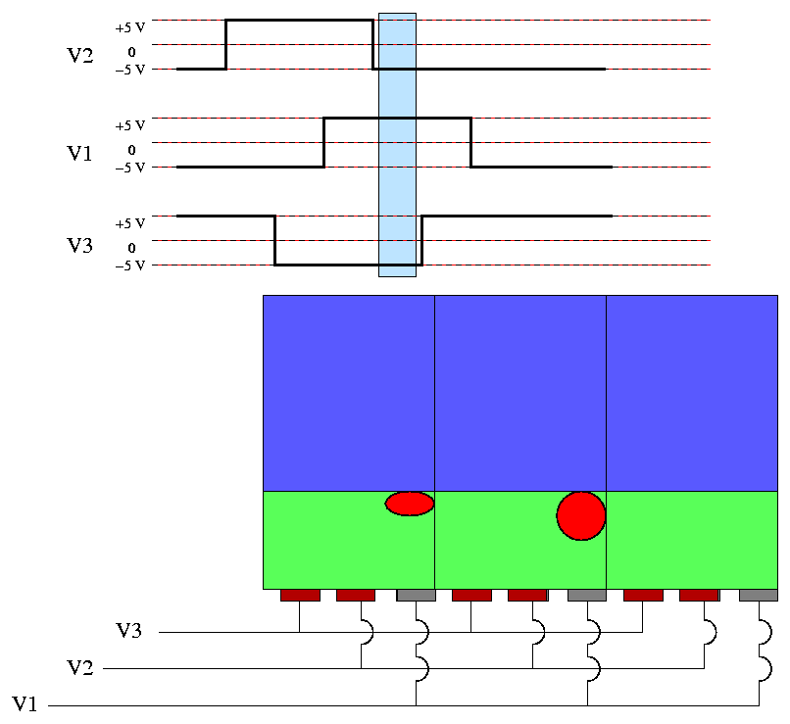
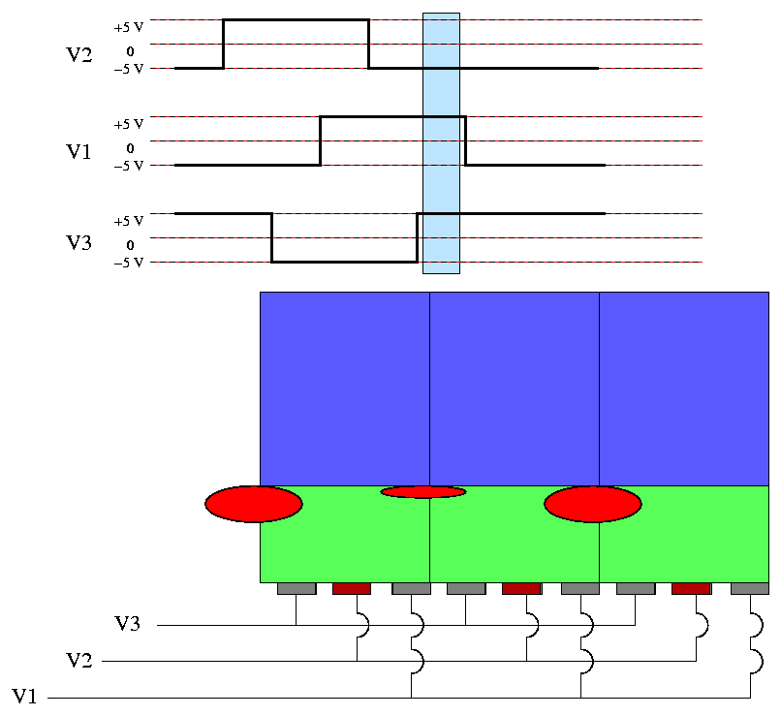
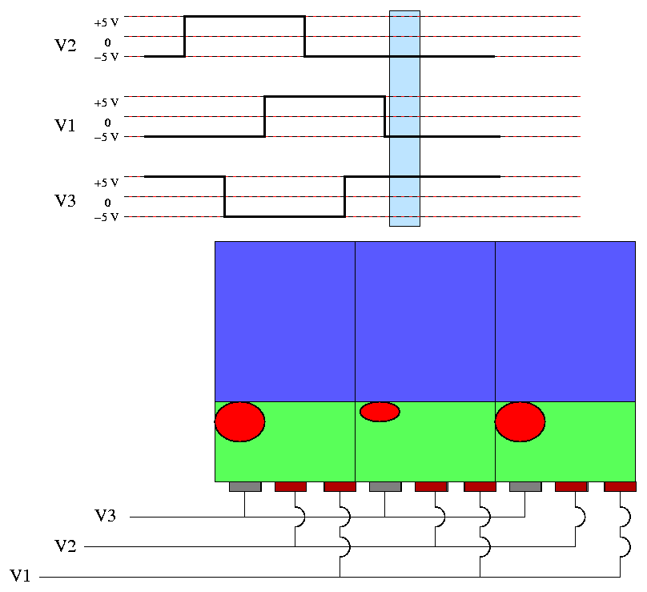
Three Phase Vertical Transfer Timing Model

Slide 14
Typical CCD Camera Front-end
µP
+ 5V
- 7.5V
+ 15V
+ 5V
+ 5V
+ 5V
SPI buss
CCD Sensor
Gain Control
Horizontal Drivers
Raw Pixel Output
Digital Output
Pixel Buffer
Double Correlating A/D
+ 5V
Timing
Vertical Drivers
Notes
Each Block is an Individual Component/s.
Typically three Power Supply Voltages Required
/Sync
+ 5V
+ 15V
FPGA is programmable via the µP

Slide 15
Design considerations.
Power supplies must be low noise.
Clocks are derived from frame rate (10 fps) (13 mega pixels/sec).
Horizontal drive (pixel clock = 13mhz). Need to drive 40 pfd.
Vertical clock needs to transfer 1434 shifts/frame 14.34 khz clock rate. Need to drive 22000 pfd.
Components are selected for appropriate bandwidth.

Slide 16


Accounting for noise sources in a CCD
S _{led}
S
N
S _{led} + (N_{amb} + N_{dark} + N ²_{readout} )
dark noise: 30 electrons / pixel
readout noise: 12 electrons / pixel
bias noise / offset level: 1300 electrons / pixel
CCD max out put voltage of .3 volts = 1,187,500e-
Reset noise = 126e-
Reset noise voltage = .203 mVrms
White noise = 5.75 uVrms
Important: Using gain of 3, a 10 bit A/D, and a 1 volt reference. 1volt/1024 = 1mV per bit.
Note: Temperature was worst case at 25C

Slide 17

FBI Appendix F Specs For Image Quality Summarized
500 Dots Per inch
Must resolve 20 line pairs per mm. at 10 % MTF. (50 microns)
At least 80.0% of the captured individual fingerprint images shall have a gray-scale dynamic range of at least 200 gray-levels, and at least 99.0% shall have a dynamic range of at least 128 gray-levels.
SNR = The white signal-to-noise ratio and black signal-to-noise ratio shall each be greater than or equal to 125.0, in 97% of the test cases. (Use to set up a low reflectance target and a high reflectance target. They split the scale.)

Slide 18
MTF Test Procedure
Illumination
MTF CURVE
Target
Linear System
Response
Spatial Frequency

Slide 19
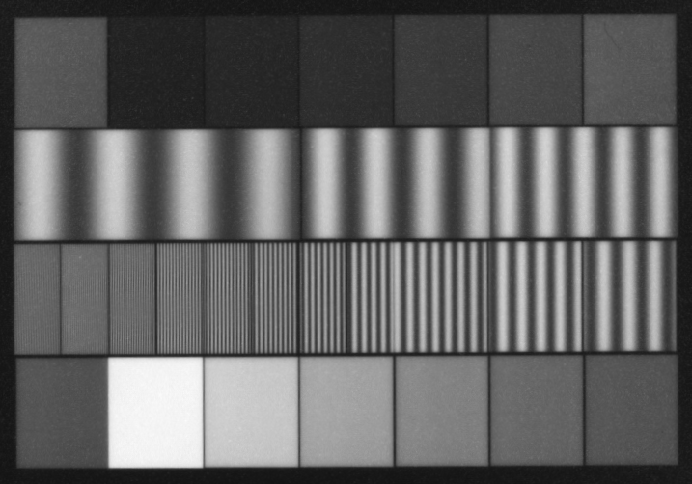
MTF Test Pattern

Slide 20
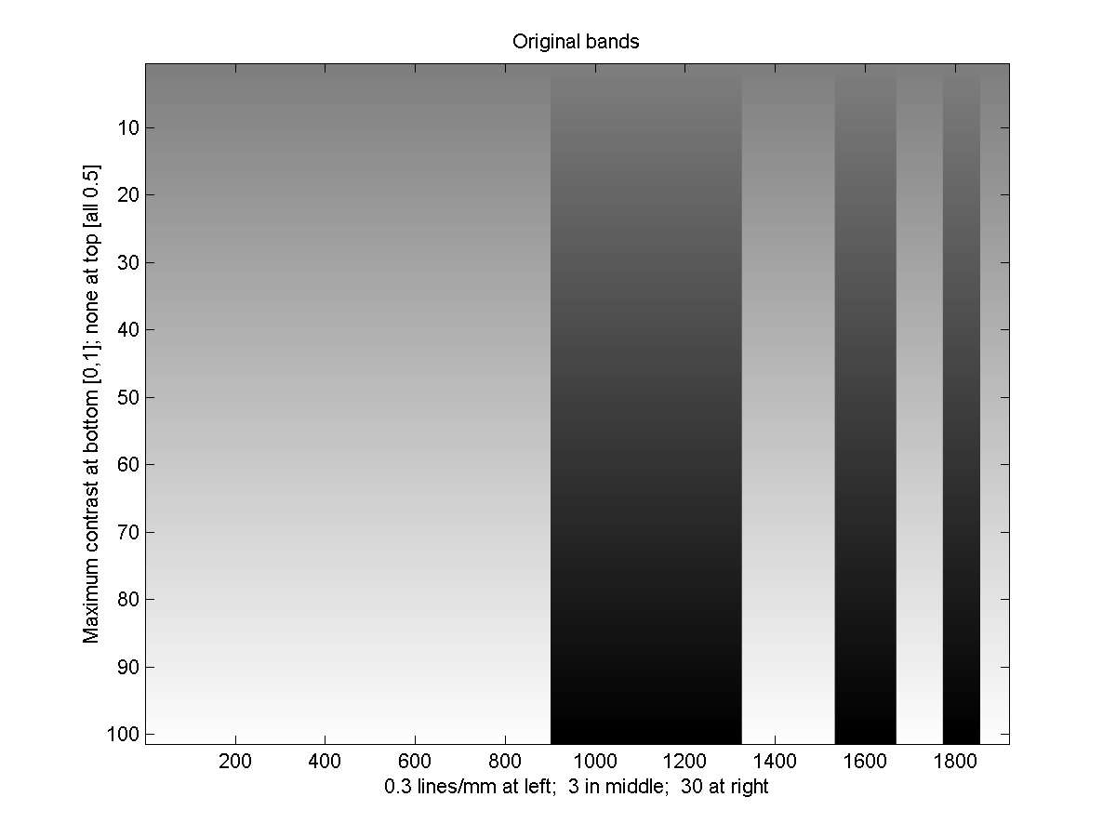
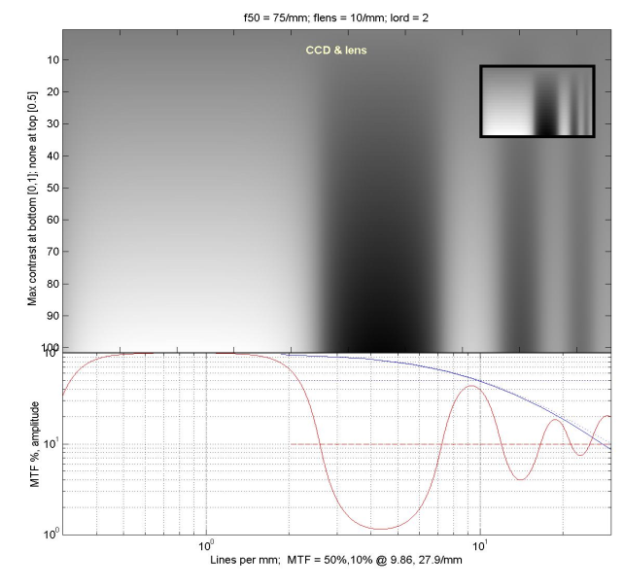
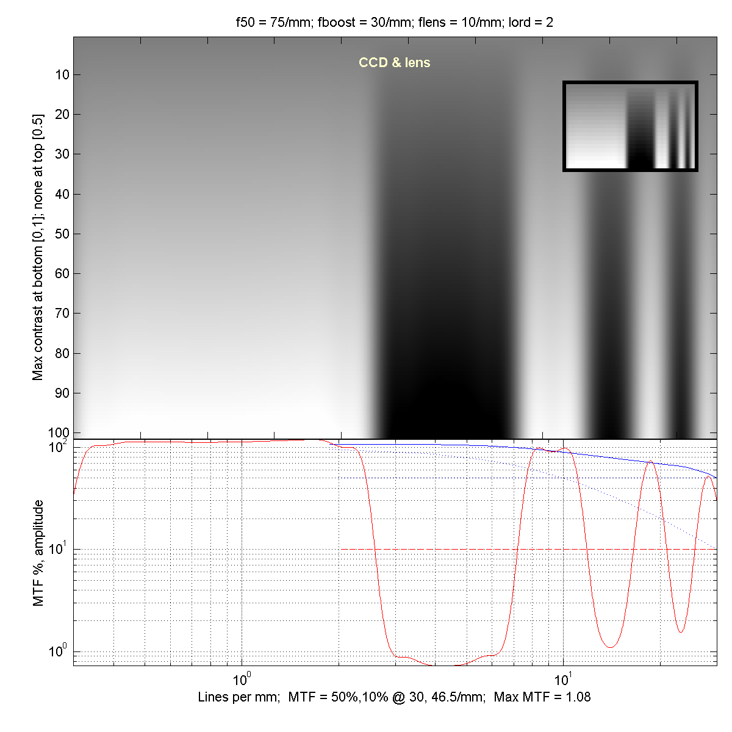
MTF Test Data

Slide 21
Design Control
Design Control did not formally exist at Identix.
Past: R&D co-exited with manufacturing. Company was traditionally, “engineering” driven.
Present: R&D was now geographically separated from Manufacturing.
Took the approach that manufacturing group was my customer.
Opened a dialogue with manufacturing organization.
Resolved what they needed to succeed.
Worked with Intek (Russia) to develop the analysis/process control tools and optical system test techniques.

Slide 22
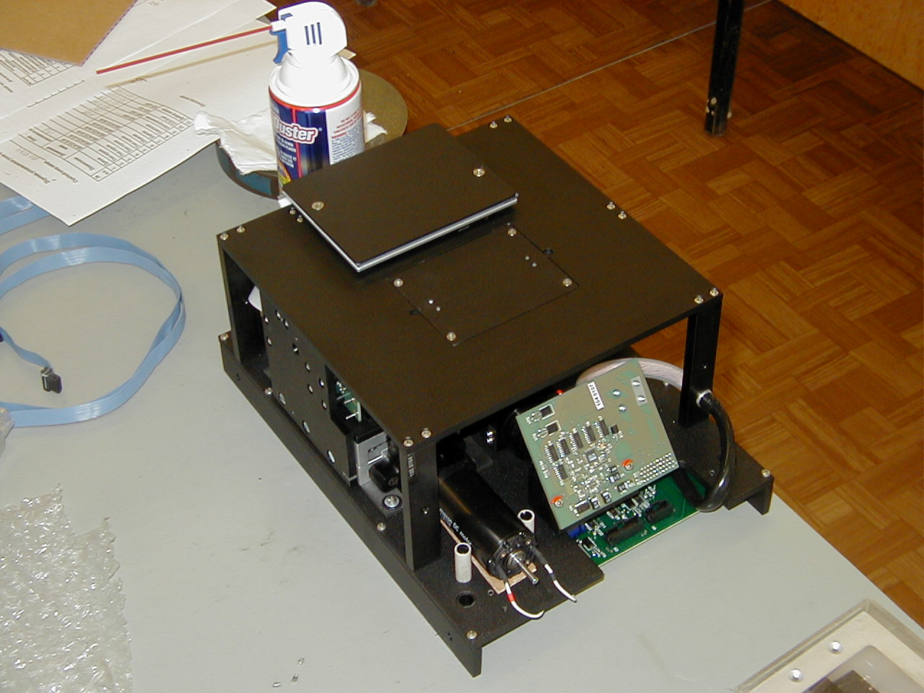
Scanner Assembly

Slide 23
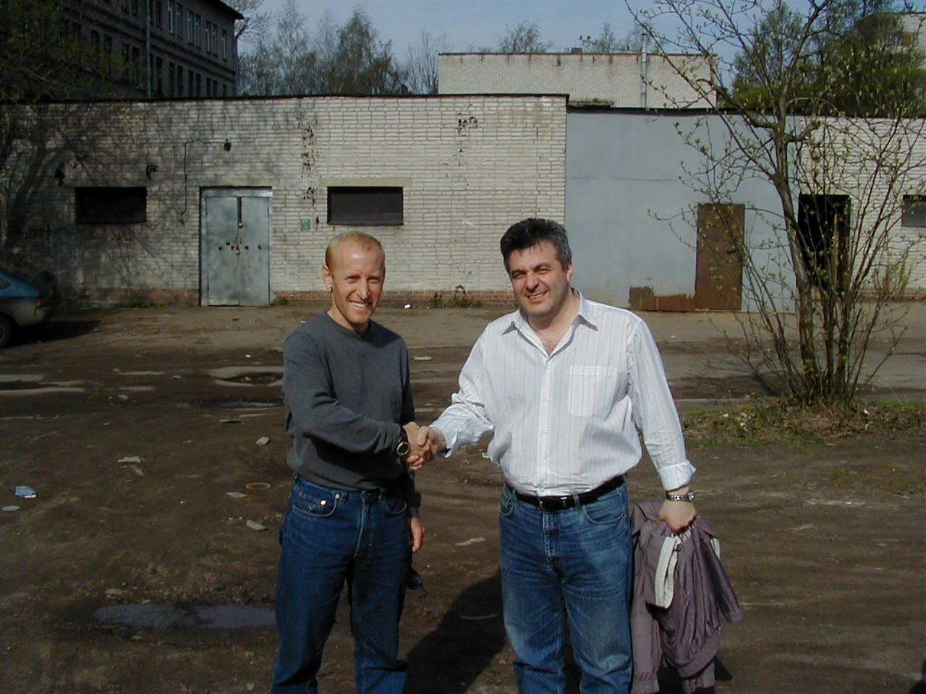
Team play + process = quality
(and happy customers)

Slide 24
Results and Project Conclusions.
Camera/imaging system received FBI, UL, and FCC certification.
Camera was integrated into TP 2000 later renamed to TP 3800.
Scanner yields greatly improved.
First systems shipped in January 2002.
Identix shipped 20 systems per month in 2001-2002.
Identix merged with Visionics in 2/2002.

